Slide 1
Tourism Impacts and Sustainable Development

Slide 2
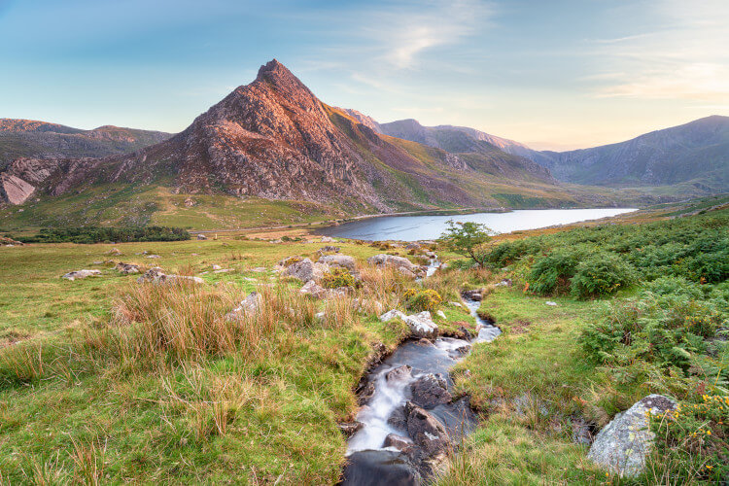
Research Background & Context
Eryri is a major protected tourism destination in Wales
Tourism generates economic and recreational benefits
Rising visitation increases environmental pressures
Sensitive landscapes face growing sustainability challenges (Tsypko, 2024)
Key pressures include erosion, congestion and waste
Sustainable tourism requires conservation alongside visitor access
Notes:
Eryri National Park is a significant protected tourism site in Wales, providing opportunities to enjoy recreation, the landscape and outdoor activities. Tourism is beneficial economically and socially; however, when tourism grows in numbers and activities, it may exert pressure on the environment (Tsypko, 2024). Erosion, congestion, waste, and disturbance of habitats are important issues. Thus, there is a need for a balance between use and protection of the natural environment in the process of sustainable tourism (Walliman, 2020). Eryri is also significant as a protected landscape where tourism and conservation are in harmony. The mountains and walking routes and the natural beauty draw visitors in, providing opportunities for local businesses and communities. But, the more visitors the site receives, the more it will stress the natural resources. Thus, it is not only a matter of attracting visitors to an area, but also a matter of managing the activity of visitors so that they do not diminish the environmental quality that makes the destination attractive

Slide 3
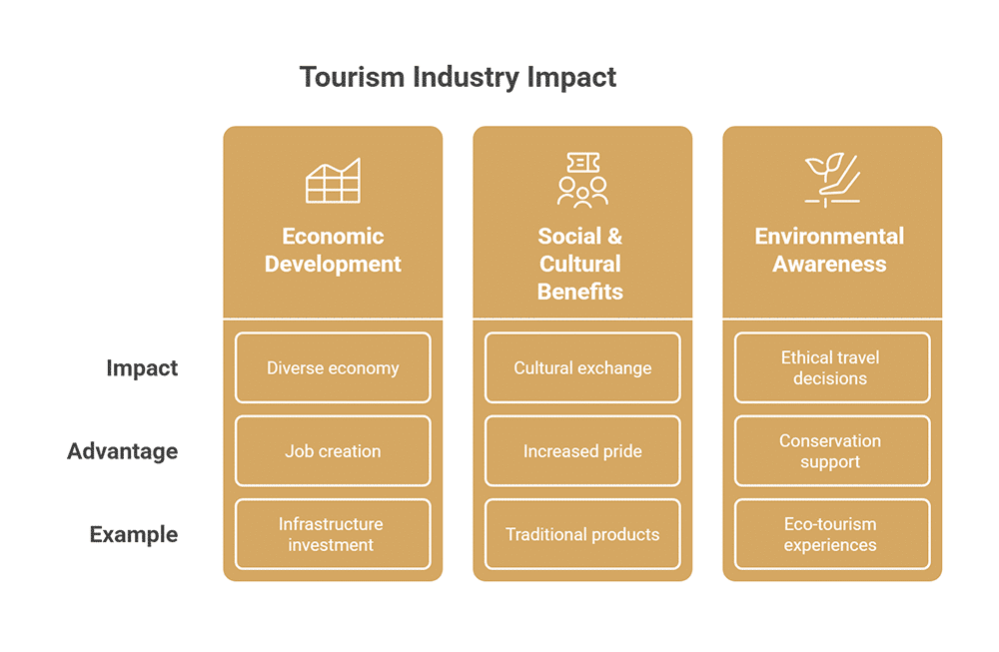
Research Problem
Increasing tourism creates pressure on protected environments
Popular routes experience significant path erosion
Habitat disturbance and traffic congestion are concerns
Waste and carbon emissions increase environmental pressure (Baloch et al. 2023)
Limited research integrates multiple pressures in Eryri
Research gap: Limited integrated analysis of environmental pressures, management strategies and implementation challenges
Notes:
As the number of visitors to Eryri grows, there are challenges to its environmental sustainability as a protected landscape. Waste generation, carbon emissions, traffic congestion, habitat disturbance and path erosion are potential negative effects of high visitor use. Management actions are available, but they may not always be as effective due to resource constraints, visitor behaviour and implementation challenges (Baloch et al. 2023). The research thus fulfils the need for a more integrated understanding of the tourism pressures and their sustainable management. These pressures may also occur together in a way that is different. For instance, many visitors may lead to traffic congestion, waste and greater usage of walking paths at once. Chronic pressure in sensitive areas can lead to a progressive degradation of the environment and more need for conservation resources. This is why integrated approach is crucial. Sustainable management must address how the various environmental pressures are related, and how management responses can address them as a whole.

Slide 4
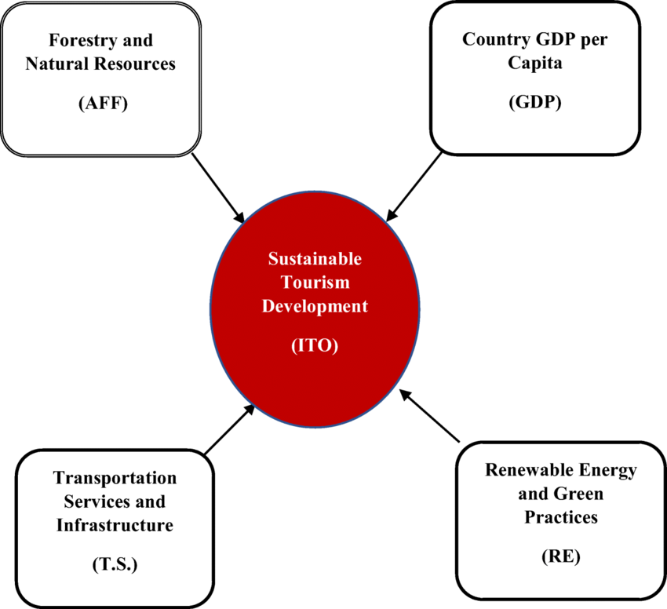
Aim, Objectives & Research Questions
Research Aim
To investigate tourism impacts on sustainable development by analysing environmental pressures in Eryri and evaluating sustainable management strategies.
Objectives
Examine tourism, environmental impacts and sustainability literature
Identify major tourism-related environmental pressures
Assess sustainable tourism and conservation strategies
.Examine challenges affecting implementation
Research Questions
What are the major environmental impacts of tourism?
How do tourism activities affect sustainable development?
How effective are current management practices?
What barriers affect sustainable tourism implementation?
Notes:
The study sets out to explore how tourism affects sustainable development by studying environmental pressures in Eryri and the sustainable management of this environment. The research has four objectives: the review of relevant literature; identification of major environmental pressures; evaluation of management and conservation strategies; and exploration of the challenges to implementation. The research questions are centred on tourism effects, sustainable development, management effectiveness and obstacles to the implementation of sustainable tourism in the park.

Slide 5
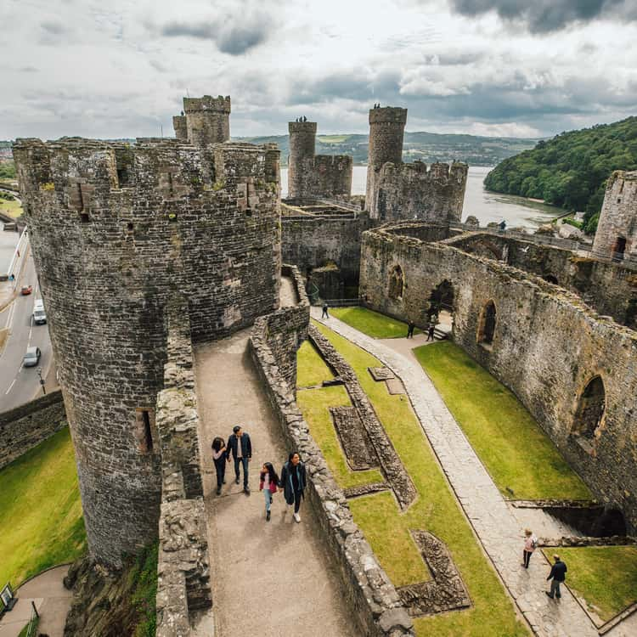
Significance of the Study
Why This Research Matters
Connects tourism with environmental sustainability
Highlights pressures affecting protected landscapes
Supports improved tourism management decisions
Identifies gaps in existing research (Ali et al. 2025)
Provides practical direction for sustainable management
Contribution: Supports evidence-based and collaborative management of protected tourism destinations.
Notes:
The study is important because of the need to balance environmental protection and the economic and recreational benefits of protected tourism destinations. A study of Eryri offers valuable perspectives on the impact of tourism pressures on sustainable development and management responses to those pressures. The research also identifies areas of missing content in the literature and provides evidence for decision-making. Deeper participation of authorities, communities, businesses, visitors and conservation organisations can enhance sustainable destination management (Ali et al. 2025).
Another important aspect of the research is its consideration of multiple interests that is important for sustainable tourism. Tourism can be good for local economies, tourists look for interesting natural environments, businesses rely on tourists, and conservation organisations look to preserve natural environments. Not all of these interests prioritize the same things. Therefore, communication and cooperation amongst stakeholders is key to good management. Environmental issues are thus not only at the heart of the study but also the ways in which various segments can have a role in sustainable destination management.

Slide 6
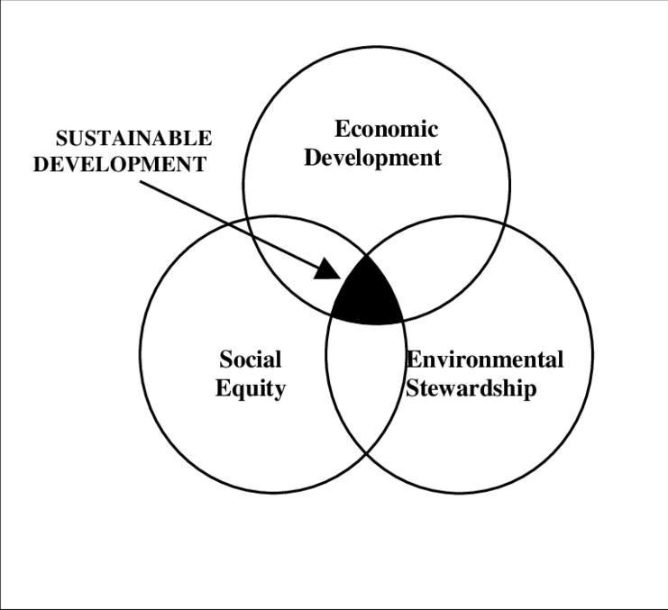
Key Literature & Theoretical Perspectives
Theoretical Foundation
Sustainable Development Theory
Balances environmental, economic and social needs
Protects resources for future generations (Haribudiman et al. 2023)
Tourism Carrying Capacity Theory
Recognises ecological and physical limits
Supports visitor and resource management
Stakeholder Theory
Emphasises shared responsibility
Supports collaboration among key stakeholders
Notes:
There are three theoretical perspectives supporting the research. Sustainable Development Theory emphasises the importance of the balance between environmental, economic and social issues (Haribudiman et al. 2023). Tourism Carrying Capacity Theory highlights the ecological and physical capacity of destinations and the need to manage the pressure of tourists. Stakeholder Theory emphasises the mutual accountability of stakeholders: authorities, communities, businesses, tourists and conservation groups. These perspectives combine to offer a lens through which to view tourism impacts and management responses (Greetham, 2019).

Slide 7
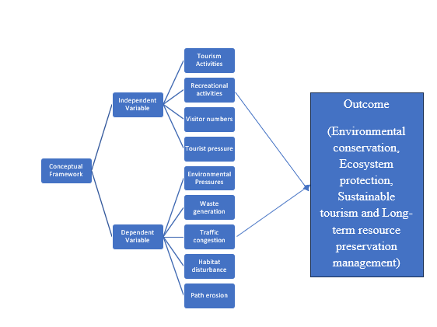
Conceptual Framework & Literature Gap
Literature Gap
Studies often examine individual environmental pressures
Limited integration of multiple pressures
Practical implementation challenges receive less attention (Meera and Vinodan, 2023)
Limited focus on their combined effect in Eryri
Conceptual Framework
Notes:
The conceptual framework has been established to connect tourism activities to environmental pressures and sustainable development outcomes (Meera and Vinodan, 2023). Erosion, habitat disturbance, traffic and waste are potential impacts from visitor numbers, recreational activities and tourism pressure. These pressures can be lessened by management and interventions like visitor control, conservation, monitoring and stakeholder collaboration. The literature gap relates to the lack of integration of multiple environmental pressures into practical management and implementation issues, particularly in Eryri.

Slide 8
Research Methodology
Element | Selected Approach
Philosophy | Interpretivism
Approach | Inductive
Design | Exploratory
Research Choice | Qualitative secondary research
Time Horizon | Cross-sectional
Analysis | Thematic analysis
Notes:
An interpretivist philosophy is employed in this study, as it needs to be interpreted in terms of the available evidence and varying views of the literature. In an inductive approach, one identifies recurring patterns, instead of testing preconceived hypotheses. An exploratory design is suitable for gaining insight into the environmental pressures associated with tourism. Qualitative secondary research was chosen, which involved using evidence from other academic and organisational sources, and thematic analysis was used to identify important patterns (Gamage, 2025).

Slide 9
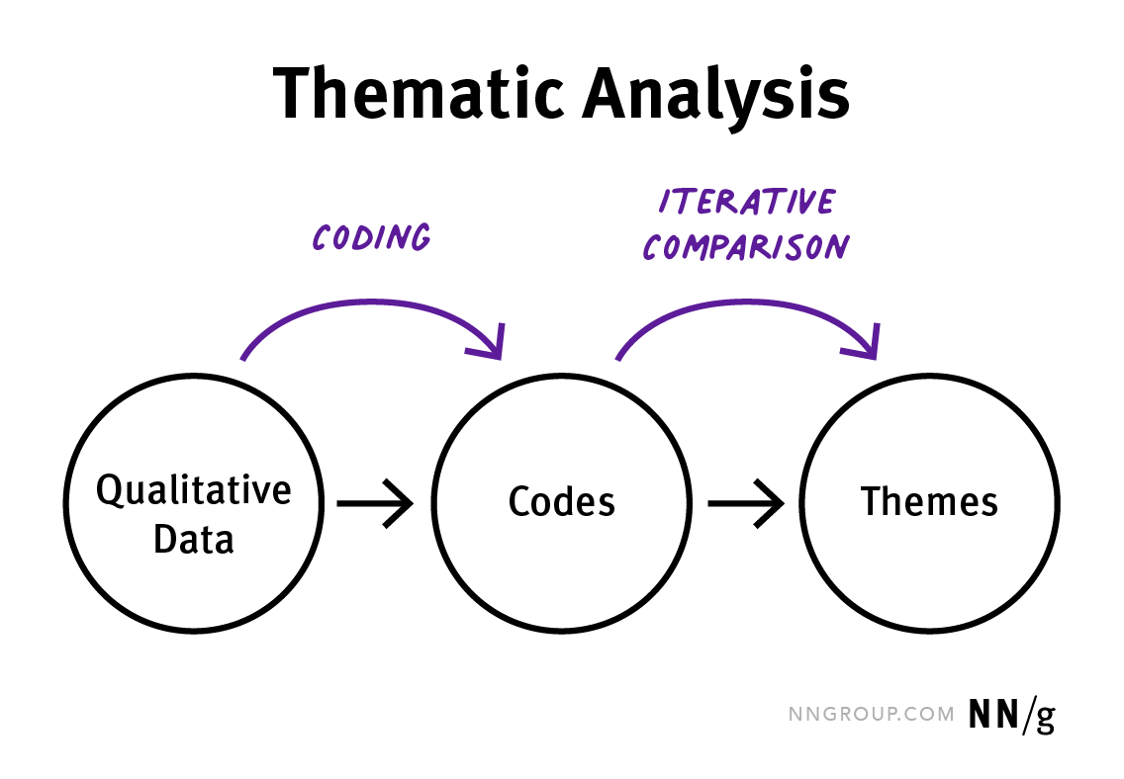
Data Collection & Analysis
Data Collection:
Peer-reviewed journal articles
Government publications
Organisational reports
Academic literature
Google Scholar, Scopus and ScienceDirect
Predetermined keywords and inclusion criteria
Analysis Process:
Literature selection → Coding → Theme development → Interpretation
Thematic analysis identified recurring patterns across the evidence.
Notes:
Peer-reviewed journal articles, government publications, organisational publications and academic sources were used to gather secondary data. Relevant keywords and selection criteria were used to search platforms such as Google Scholar, Scopus and ScienceDirect. The analytical process was done by literature selection, coding, theme development and interpretation. Thematic analysis allowed for the identification of recurring patterns with evidence and the organisation of these themes into four primary themes related to the research objectives (Saunders et al. 2023). There are several kinds of secondary sources used in the research to influence a wider evidence base. Academic articles can give an academic point of view and government and organisational publications can give practical and policy related information. Relevant literature is also selected through the use of predetermined keywords and inclusion criteria. In the process of thematic analysis, data from different sources was compared to look for similarities and common issues. Afterwards themes were sorted by the research goals, to keep the findings in relation to the purpose of the study.

Slide 10
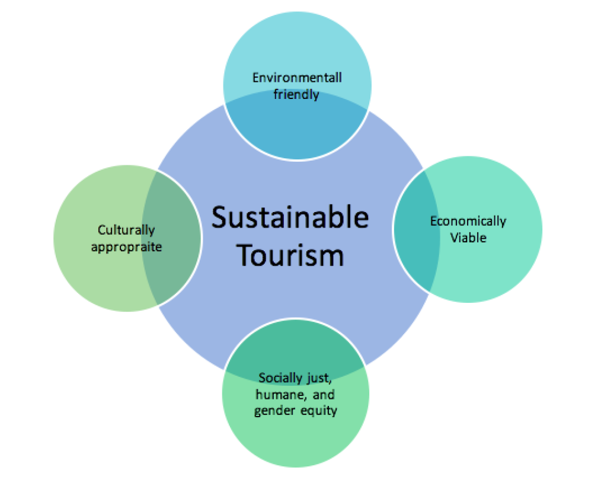
Findings: Tourism & Environmental Sustainability
Theme 1: Tourism, Environmental Impacts & Sustainable Development
Tourism provides economic and recreational benefits
Protected landscapes have strong social value
Tourism must balance access with conservation (Elgin and Elveren, 2024)
Environmental indicators support sustainability evaluation
Economic benefits should not dominate environmental priorities
Notes:
The first theme illustrates how tourism benefits destinations economically and recreationally, but also brings environmental pressures to protected destinations. Eryri is a place of social and environmental importance, and therefore any development of tourism must be balanced against conservation. When it comes to sustainable development, the economic aspects must be taken into account along with environmental protection. The literature shows that the right environmental indicators and the right management are fundamental to sustain this equilibrium in the long term (Elgin and Elveren, 2024).
The results show that tourism is not only a positive or negative phenomenon, in and of itself. Its contribution is dependent on the planning and management of tourism in the destination. Economic and recreational values can be beneficial, contribute to the local economy and enhance the opportunities for visitors, but can become less sustainable if environmental degradation gets worse. Ensuring landscape quality is of special importance in a protected area, like Eryri, where landscape is a key factor in the destination's tourism attractiveness. Use and protection are thus complementary in sustainable development.

Slide 11
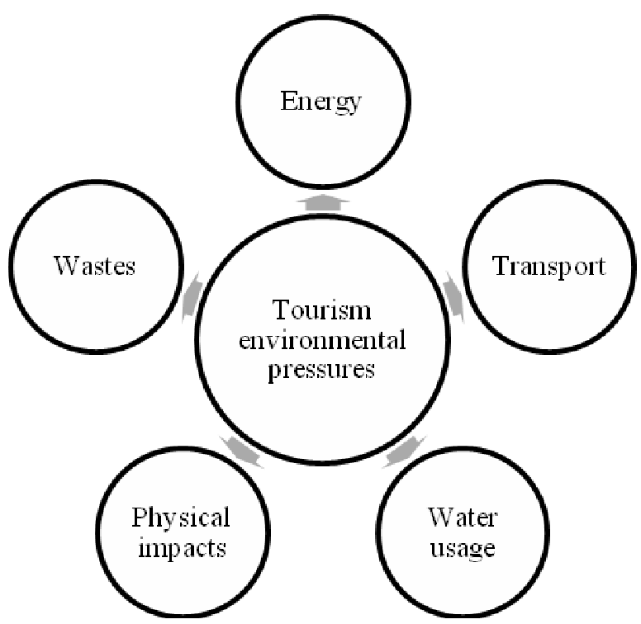
Findings: Environmental Pressures
Theme 2: Environmental Pressures from Tourism
Recreational activity can disturb biodiversity
High visitor use increases environmental pressure
Path erosion affects sensitive locations
Tourism contributes to carbon emissions (Mejjad et al. 2022)
Waste and habitat disturbance remain concerns
Impacts occur locally and beyond destinations
Notes:
The second theme relates to the major environmental pressures of tourism. Increased visitor use may lead to erosion of paths, disturbance of biodiversity, generation of waste and carbon emissions. Recreational activities can add extra stress to sensitive habitats and highly used areas. The effects illustrate how the pressure of tourism is not just a function of the number of tourists visiting protected areas, but also of the kind of activities undertaken and their intensity (Mejjad et al. 2022).

Slide 12
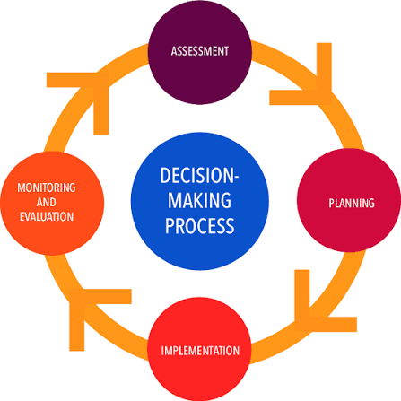
Findings: Sustainable Management
Theme 3: Management & Conservation Strategies
Evidence-based planning improves decision-making
Stakeholder participation strengthens conservation
Open science supports knowledge sharing (Pham et al. 2025)
Governance enables stronger climate action
Visitor management reduces environmental pressure
Collaboration supports long-term sustainability
Notes:
The third theme deals with strategies that can be used to support sustainable tourism and conservation. Use evidence to enhance management decisions and monitor visitors to reduce pressure on sensitive areas. Infrastructure and conservation measures can minimise environmental damage. Stakeholder involvement is also crucial as park stakeholders have varying roles. Long-term sustainability can thus be enhanced by collaboration, knowledge sharing and good governance (Pham et al. 2025). Reliable and accurate information is also essential to good sustainable management. By tracking visitors and environmental conditions, decision makers can get a sense of where pressures are rising and if interventions are having the desired effects. This evidence can be complemented by stakeholder involvement by providing experiential knowledge and other points of view during decision-making processes. Cooperation is thus necessary as no single organisation is empowered to solve all the environmental pressures associated with tourism. Management must be responsive to changes in the way visitors use a site, environmental conditions and tourism trends to be sustainable in the long term.

Slide 13
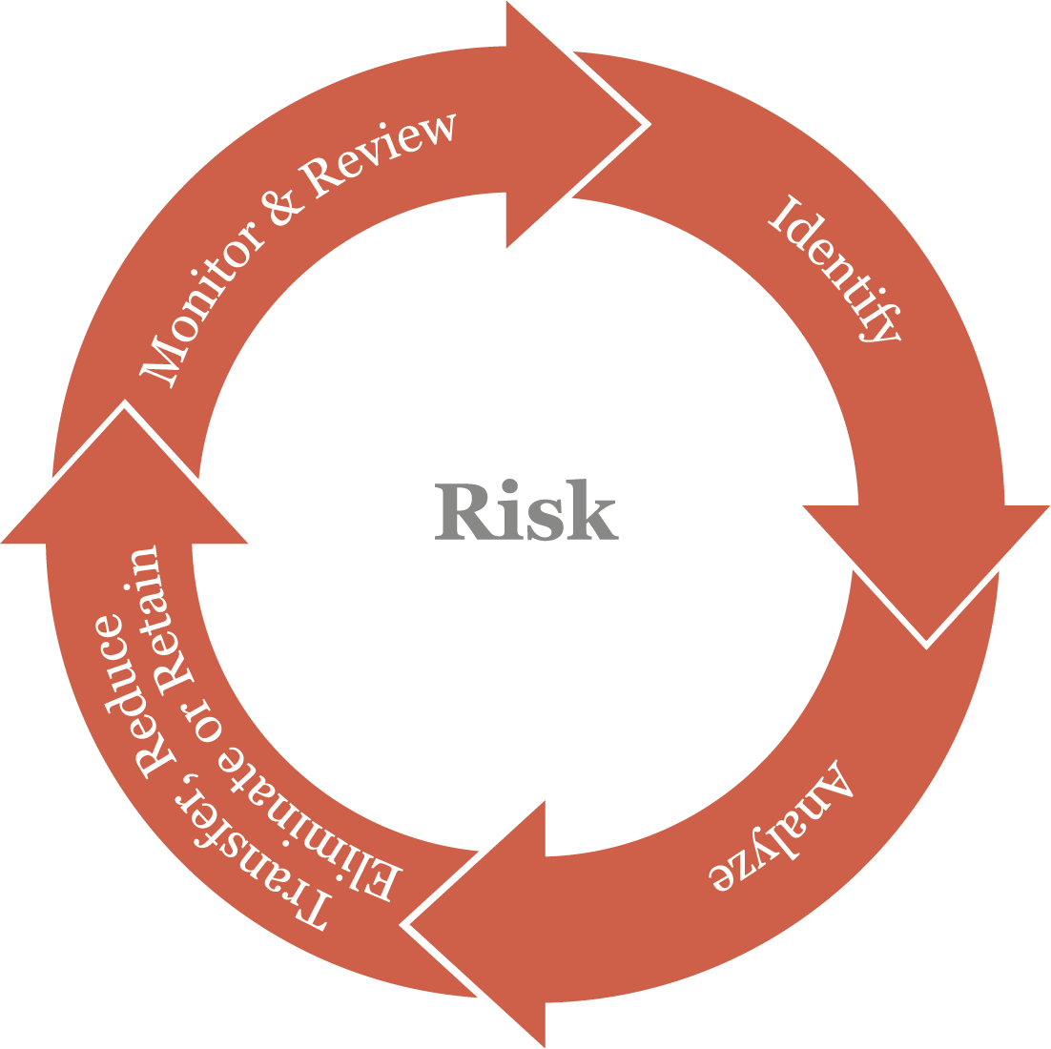
Findings: Implementation Challenges
Theme 4: Implementation Challenges
Visitor behaviour can limit policy effectiveness
Planning creates practical sustainability barriers
Tourist perceptions affect acceptance of change
Limited resources constrain implementation
Stakeholder interests may conflict (Hussain et al. 2024)
Weak coordination reduces policy effectiveness
Notes:
The fourth theme identifies barriers which can impede sustainable tourism strategies from delivering the desired results. Environmental actions can be affected by visitor actions and perceptions. Financial and organisational resources may limit implementation and may be complicated by conflicting stakeholder interests. The effectiveness can be further decreased by weak coordination and policy implementation. The challenges are proof that sustainable tourism is a topic that needs to be communicated, educated, cooperated on, and well-governed (Hussain et al. 2024). These are a few challenges that show that it is not enough to have a sustainability policy that will lead to successful implementation. People might not always be able to cope with restrictions or environmental advice and there may be financial or operational constraints for organisations. The different stakeholders might also hold different views on the priority they wish to set for tourism development, conservation and access. Coordination is, therefore, necessary. Implementation can be made easier with clear communication, involvement of stakeholders and allocation of appropriate resources. Not just appropriate strategies are needed for sustainable tourism, but the organizational capacity and cooperation to implement these strategies.

Slide 14
Discussion: Findings vs Literature
Theme 1: Supports Trišić et al. (2023) and Thapa et al. (2024) — tourism benefits require a balance with conservation.
Theme 2: Supports Morse (2023) — impacts depend on activities, behaviour and site conditions.
Theme 3: Supports Sobhani et al. (2023) — evidence-based planning and stakeholder engagement improve management.
Theme 4: Supports Pai et al. (2026) and Khan et al. (2023) — governance, resources and policy barriers affect implementation.
Notes:
The findings broadly support the literature review. Theme 1 confirms the need to balance tourism benefits with conservation. Theme 2 highlights activity, behaviour and site conditions as key pressures. Theme 3 supports stakeholder engagement and evidence-based management, while Theme 4 highlights governance, resource and policy barriers affecting implementation (Hart, 2018). The results are compared with other literature, showing that the results are generally comparable to those found in the literature on sustainable tourism and protected areas. The study does reinforce however, the need to look at environmental pressures as a whole rather than one at a time. The results reveal linkages between tourism activity, environmental impacts, and management responses and implementation barriers. This holistic perspective enriches the discussion by creating a clearer link between the need to assess environmental risks and the realities of managing them for the success of sustainable tourism.

Slide 15
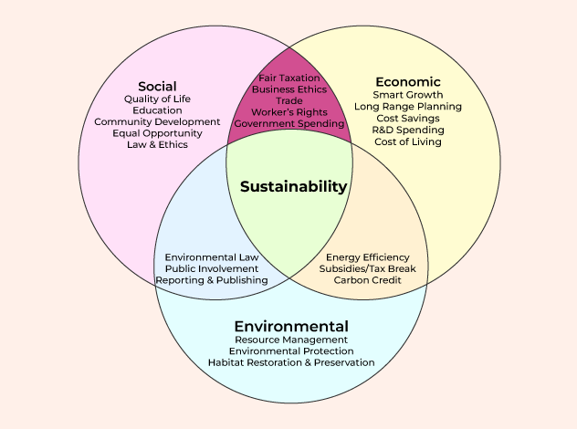
Discussion & Theoretical Link
Sustainable Development Theory
Balances tourism benefits with environmental conservation.
Tourism Carrying Capacity Theory
Tourism pressure should remain within ecological limits.
Stakeholder Theory
Collaboration and shared responsibility support effective management.
Overall Finding: Sustainable tourism in Eryri requires integrated visitor management, conservation and stakeholder collaboration.
Notes:
The results are consistent with all three theories of the study. Sustainable Development theory is an explanation of the necessity to balance tourism's benefits with the environment's conservation. The Tourism Carrying Capacity Theory emphasises the need to maintain a level of visitor activity that is not harmful to the environment (Skiniti et al. 2024). There is a need for coordinated action among different groups, which is illustrated by Stakeholder Theory. In summary, tourism pressures need effective management intervention to achieve sustainable tourism development within Eryri. The theoretical perspectives also contribute to an understanding of the need for an integrated management approach. But Sustainable Development Theory emphasizes on the importance of balancing the various aspects of development. The concept of Carrying Capacity Theory is a focus on the limits of environmental systems and the need to keep the pressure on tourism within the limits. Cooperation amongst the groups that are involved in the tourism and conservation endeavor is emphasized in the Stakeholder Theory. The combined theories indicate that no one intervention is enough to achieve sustainable tourism. It needs proper visitor control, protection of the environment, monitoring and collaboration with relevant parties.

Slide 16
Conclusions & Recommendations
Key Conclusion
Tourism can support sustainable development in Eryri only when environmental pressures are effectively managed.
Recommendations
Strengthen visitor monitoring and control
Improve sustainable paths and transport
Enhance waste-management infrastructure
Promote responsible visitor behaviour
Increase environmental education
Strengthen stakeholder collaboration
Notes:
Overall, the study provides a comprehensive analysis of the attributes of tourism and their impact on sustainable development in Eryri, concluding that tourism can be beneficial in sustainable development when environmental pressures are managed appropriately. Major recommendations are increasing visitor monitoring, sustainable paths and transport, waste-management infrastructure and visitors' responsibility. There is also a need to improve environmental education and the cooperation between stakeholders. Authorities will need to be adaptive and use evidence-based management to cope with the variations in tourism pressure while protecting the environment and access to it.

Slide 17
References
Ali, B., Khan, A.N. and Noreen, N., (2025). Analysing the Adverse Socio-Environmental Impacts of Tourism: Legal Gaps and Sustainable Solutions. The Critical Review of Social Sciences Studies, 3(3), pp.830-837. http://thecrsss.com/index.php/Journal/article/view/729
Baloch, Q.B., Shah, S.N., Iqbal, N., Sheeraz, M., Asadullah, M., Mahar, S. and Khan, A.U., (2023). Impact of tourism development upon environmental sustainability: a suggested framework for sustainable ecotourism. Environmental Science and Pollution Research, 30(3), pp.5917-5930. https://link.springer.com/article/10.1007/s11356-022-22496-w
Bowers, E.C., Stephenson, J., Furlong, M. and Ramos, K.S., (2023). Scope and financial impact of unpublished data and unused samples among US academic and government researchers. Iscience, 26(7). https://www.cell.com/iscience/fulltext/S2589-0042(23)01243-9
Elgin, C. and Elveren, A.Y., (2024). Unpacking the economic impact of tourism: A multidimensional approach to sustainable development. Journal of Cleaner Production, 478, p.143947. https://www.sciencedirect.com/science/article/pii/S0959652624033961
Gamage, A., (2025). Research design, philosophy, and quantitative approaches in scientific research methodology. Scholars Journal of Engineering and Technology. https://www.academia.edu/download/122341245/SJET_132_91_103c_published_paper.pdf
Greetham, B. (2019) How to Write Your Undergraduate Dissertation. 3rd edn. Basingstoke: Palgrave.
Haribudiman, I., Berliandaldo, M. and Fasa, A.W.H., (2023). Implications of the role of tourism carrying capacity in the development of sustainable tourism destinations. Jurnal Kepariwisataan Indonesia: Jurnal Penelitian dan Pengembangan Kepariwisataan Indonesia, 17(2), pp. 272–292. https://ejournal.kemenpar.go.id/index.php/jki/article/view/772
Hart, C. (2018) Doing a Literature Review: releasing the research imagination. 2nd edn. London: Sage.
Hussain, K., Sun, H., Ramzan, M., Mahmood, S. and Zubair Saeed, M., (2024). Interpretive structural modelling of barriers to sustainable tourism development: A developing economy perspective. Sustainability, 16(13), p.5442. https://www.mdpi.com/2071-1050/16/13/5442
Khan, S.A.R., Yu, Z. and Farooq, K. (2023) Green capabilities, green purchasing, and triple bottom line performance: Leading toward environmental sustainability. Business strategy and the environment, 32(4), pp.2022-2034. https://doi.org/10.1002/bse.3234
Meera, S. and Vinodan, A., (2023). Sustainability initiatives, development and well-being: understanding linkages in tourism. Society and Business Review, 18(4), pp.572-591. https://www.emerald.com/sbr/article/18/4/572/347854
Mejjad, N., Rossi, A. and Pavel, A.B., (2022). The coastal tourism industry in the Mediterranean: A critical review of the socio-economic and environmental pressures & impacts. Tourism Management Perspectives, 44, p.101007. https://www.sciencedirect.com/science/article/pii/S2211973622000721

Slide 18
References
Morse, W.C. (2023) ‘Protected area tourism and management as a social-ecological complex adaptive system’, Frontiers in Sustainable Tourism, 2, 1187402. https://doi.org/10.3389/frsut.2023.1187402
Pai, C.H., Zhang, Y., Wang, Y.L., Li, K. and Shang, Y. (2026) Current challenges and opportunities in cultural heritage preservation through sustainable tourism practices. Current Issues in Tourism, 29(5), pp.1016-1034. https://doi.org/10.1080/13683500.2024.2443776
Pham, K., Andereck, K.L. and Vogt, C.A., (2025). Stakeholders’ involvement in an evidence-based sustainable tourism plan. Journal of Sustainable Tourism, 33(4), pp.673-696. https://www.tandfonline.com/doi/abs/10.1080/09669582.(2023).2259117
Saunders, M., Lewis, P. and Thornhill, A. (2023) Research Methods for Business Students. 8th edn. Harlow: Prentice Hall.
Skiniti, G., Lilli, M., Skarakis, N., Tournaki, S., Nikolaidis, N. and Tsoutsos, T., (2024). A holistic approach for tourism carrying capacity estimation in sensitive ecological areas. Environment, Development and Sustainability, 26(12), pp.31971-31995. https://link.springer.com/article/10.1007/s10668-024-04805-0
Sobhani, P., Esmaeilzadeh, H., Wolf, I.D., Marcu, M.V., Lück, M. and Sadeghi, S.M.M. (2023) ‘Strategies to Manage Ecotourism Sustainably: Insights from a SWOT-ANP Analysis and IUCN Guidelines’, Sustainability, 15(14), 11013. https://doi.org/10.3390/su151411013
Thapa, K., Adhikari, H. and Stainback, G.A. (2024) ‘Tourism and national collaboration in protected areas’, Annals of Ecotourism, 3(2), Article 100151. https://doi.org/10.1016/j.annale.2024.100151
Trišić, I., Nechita, F., Milojković, D. and Štetić, S. (2023) ‘Sustainable Tourism in Protected Areas—Application of the Prism of Sustainability Model’, Sustainability, 15(6), 5148. https://doi.org/10.3390/su15065148
Tsypko, V., (2024), November. The effect of tourism on the ecological state of the environment. In E3S Web of Conferences (Vol. 587, p. 05007). EDP Sciences. https://www.e3s-conferences.org/articles/e3sconf/abs/(2024)/117/e3sconf_greenenergy24_05007/e3sconf_greenenergy24_05007.html
Walliman, N. (2020) Your Research Project: Designing, Planning, and Getting Started. 4th edn. London: Sage.

Slide 19
THANK YOU

